Slide 1
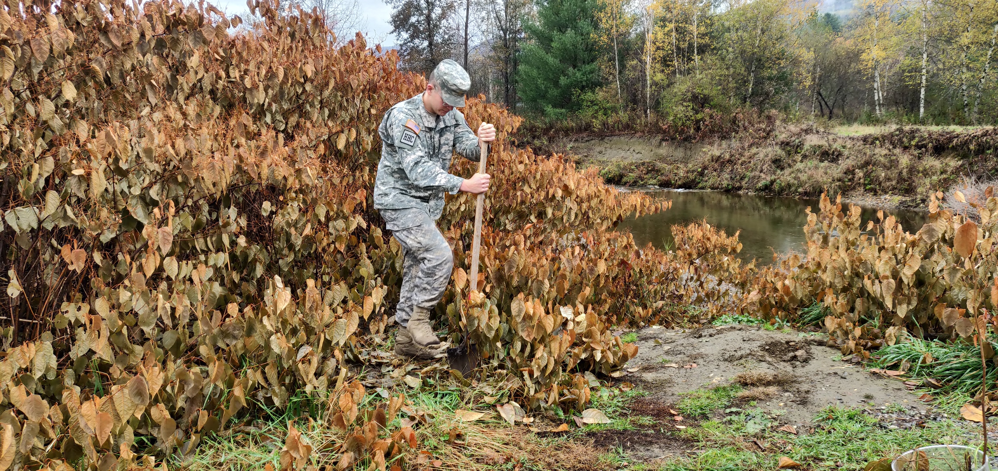
The World’s Most Invasive Species
.JAPANESE.
.KNOTWEED.

Slide 2
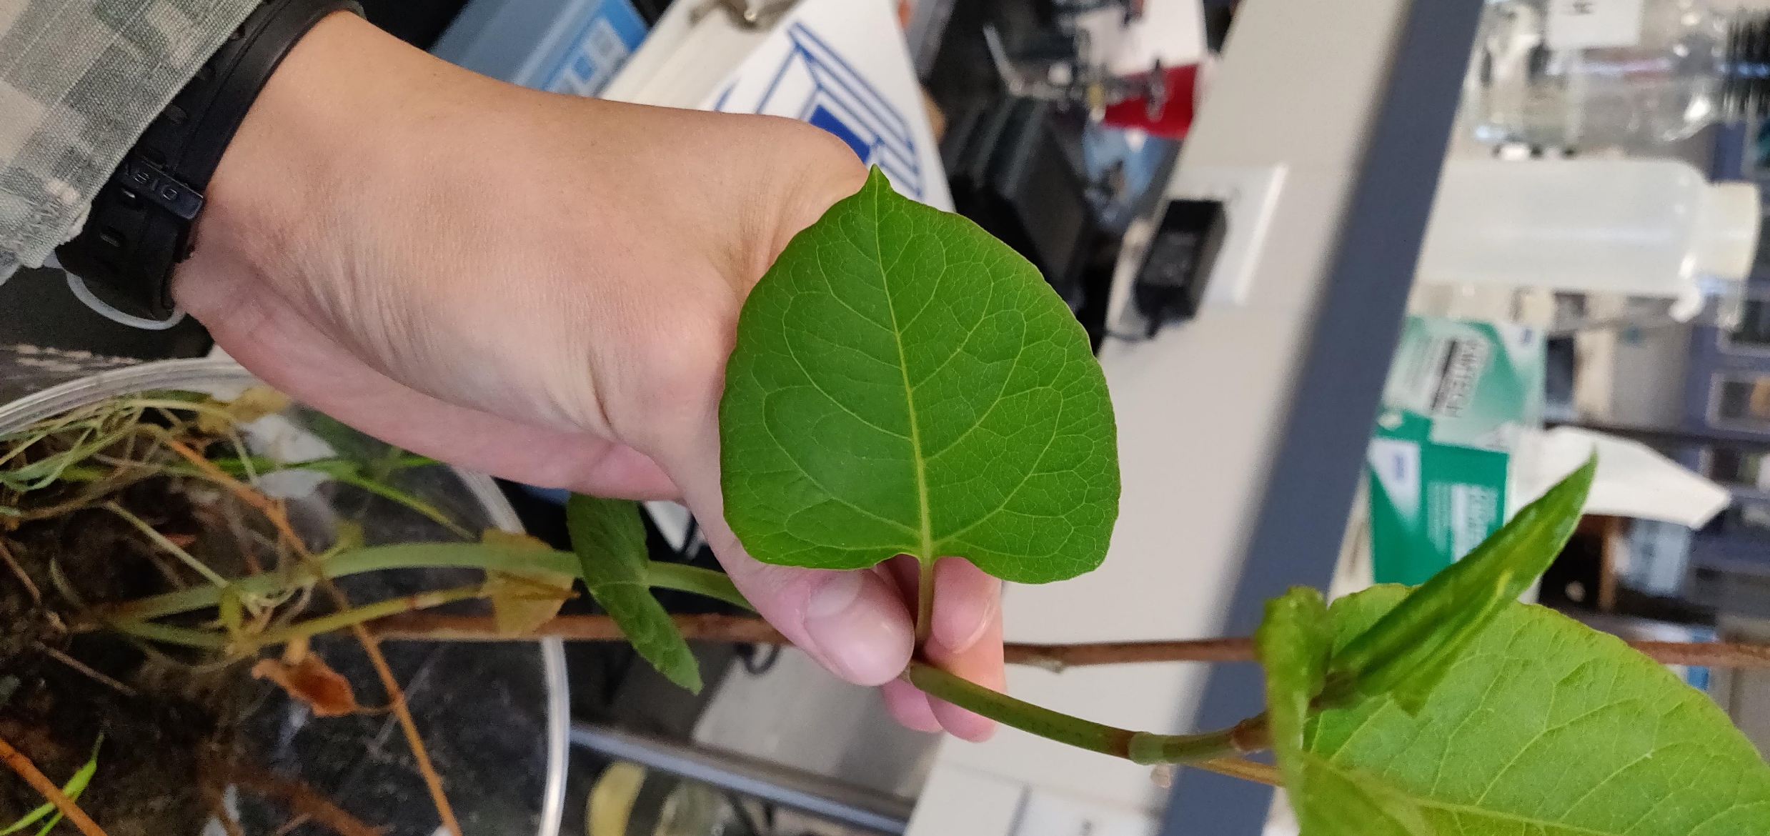

Slide 3
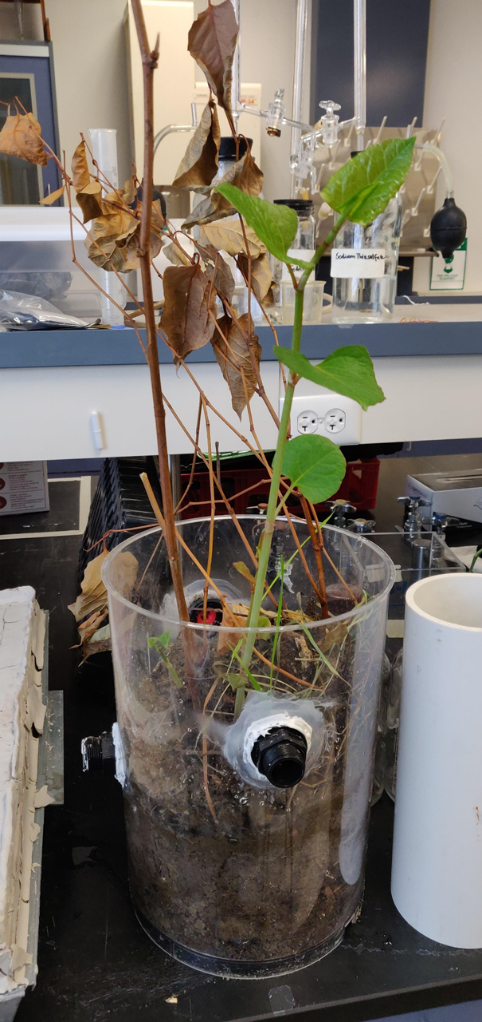
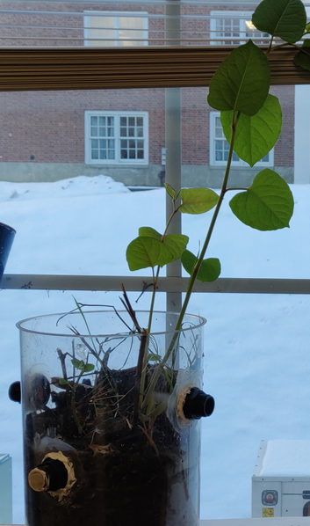
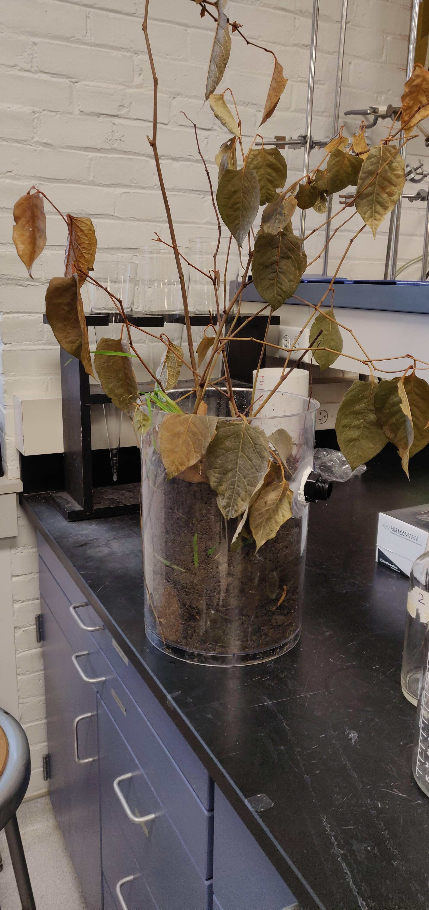
WEEK ZERO
WEEK THREE
WEEK FOUR

Slide 4
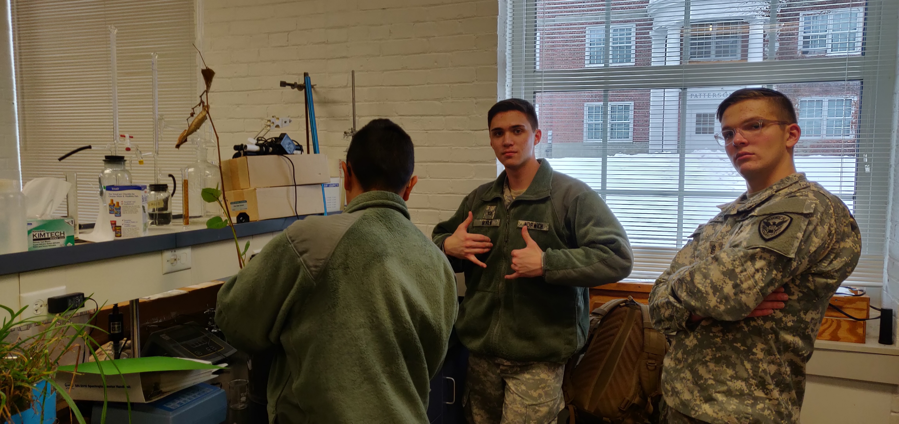
Brought to you in thanks to our sponsor Lake Champlain Basin Program

